Slide 1
Organizing Around teams
Chapter 13

Slide 4
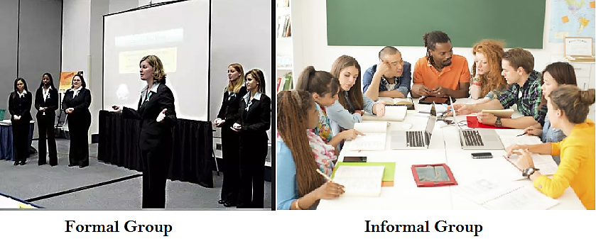

Slide 7
Remember the Titans
https://www.youtube.com/watch?v=hEJaz3sinEs

Slide 8
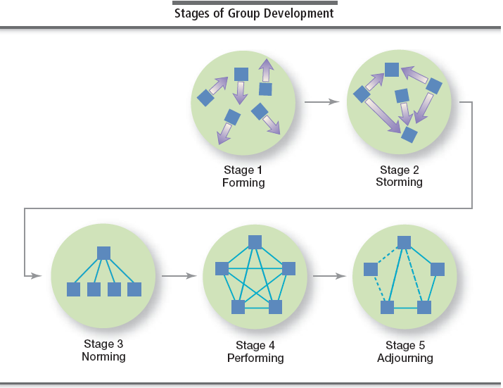

Slide 9
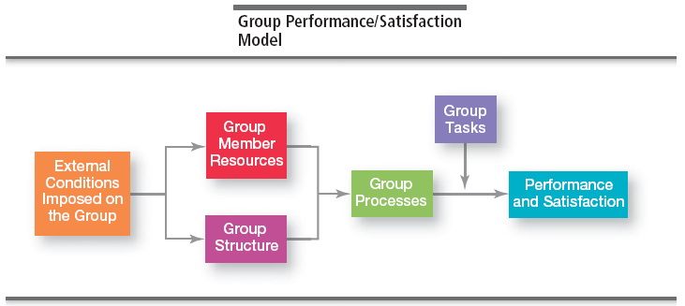

Slide 14
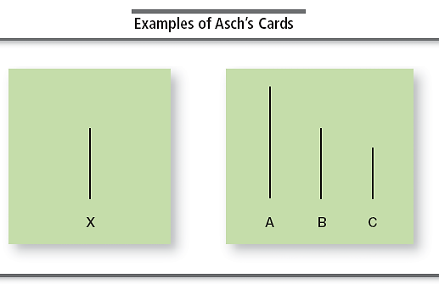
A study of Conformity - Solomon E. Asch
https://www.youtube.com/watch?v=rPEDS-0jMgs

Slide 15
